Slide 1
AI-Parking Assistant
by FalcoNS
GigaHack 2025

Slide 2


Use Case

Slide 3


Use Case

Slide 4
Use Case

Slide 5
Use Case
Forgot to pay

Slide 6
Use Case
Payment Machine is somewhere THEEERE
Forgot to pay

Slide 7
Use Case
The Question
Payment Machine is somewhere THEEERE
Forgot to pay

Slide 8


The Question
Let the car stay until paid
Let him go

Slide 9

The Question
Let the car stay until paid
Let him go
BUT
BUT
Dissatisfied customers
Money loss
`
`
`
`
:-(
:-(

Slide 10
The Question
No need to choose
Let the car stay until paid
Let him go
BUT
BUT
Dissatisfied customers
Money loss
`
`
`
`
:-(
:-(

Slide 11



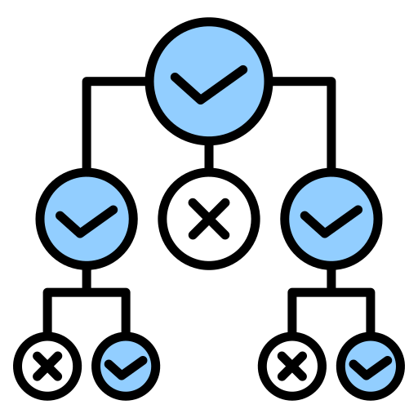
Solution
NO
LatePay system
Lane congestions
AI-Assistant
Conflicts
User-friendly Interaction
Revenue loss
Fully fact-based decisions

Slide 12

Technical Approach
Deterministic AI
Speech recognition model
Server – Database – Client – Admin API
Voice synthesis
Contextual response
Event Log

Slide 13
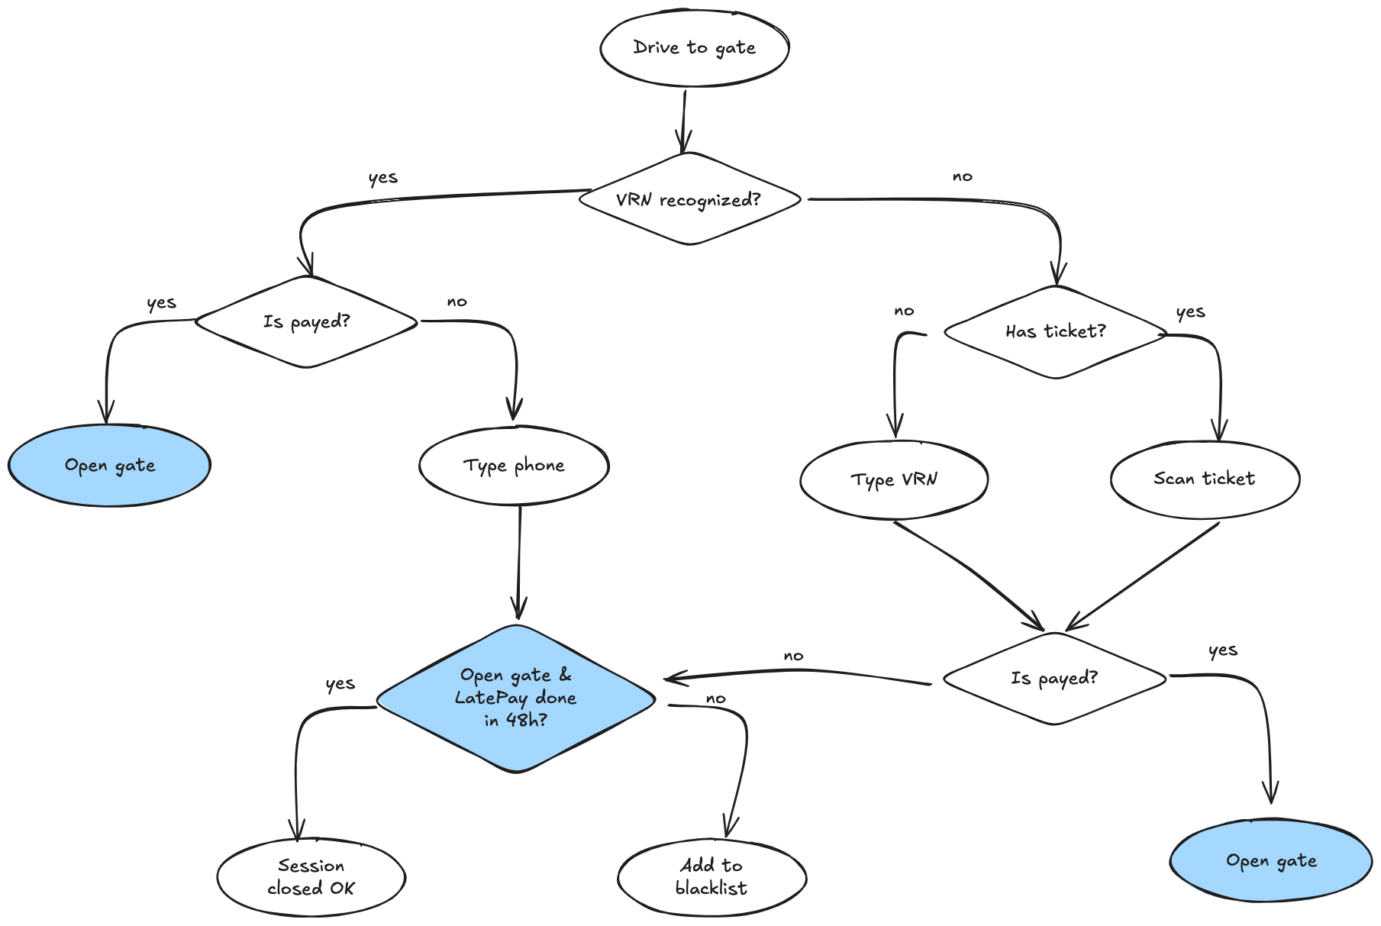
Deterministic
Model

Slide 14

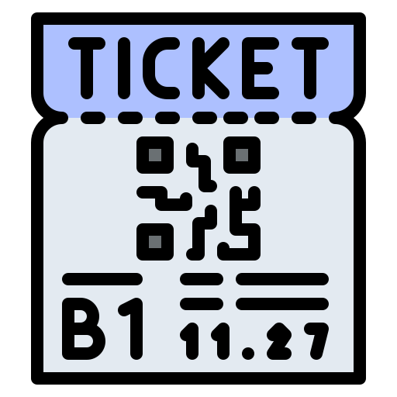


Solved Use Cases
Unpaid session at the exit station
Lost ticket
License Plate Mismatch
Payment not registered

Slide 15
Demo
Use Demonstration

Slide 16
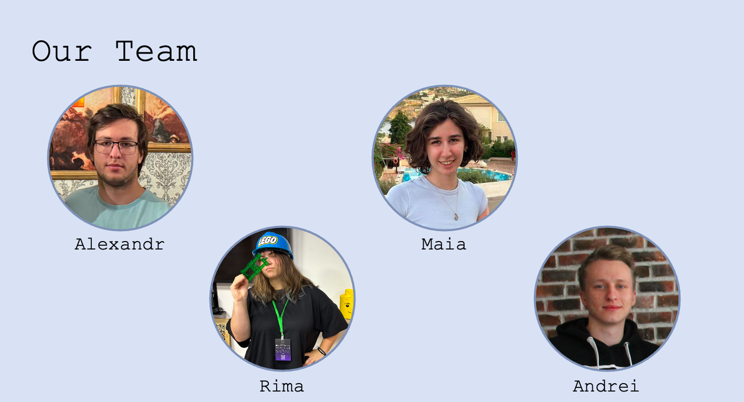

Slide 17
Q&A Session

